Slide 1

Nursing home quality in Oklahoma
Ayan Ajanaku
Morgan Missel
Demekia medley

Slide 2

There are 297 nursing homes in Oklahoma homing approximately 17,213 seniors.

Slide 3

Question page

Slide 4
Jupyter slide

Slide 5
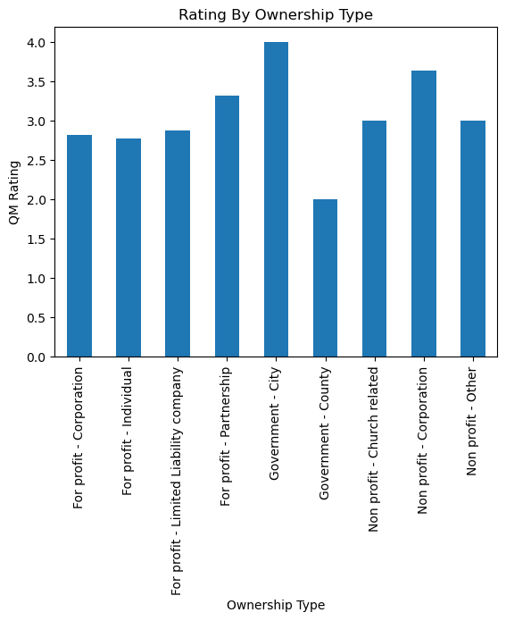

Slide 6
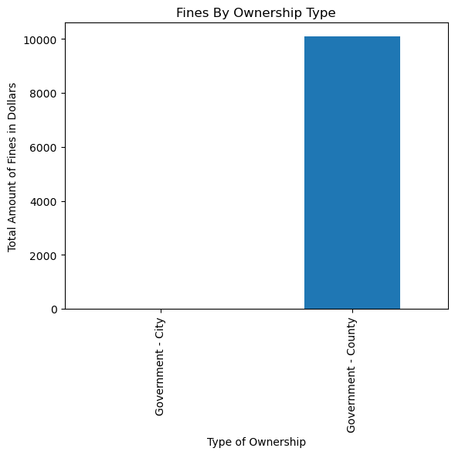

Slide 7
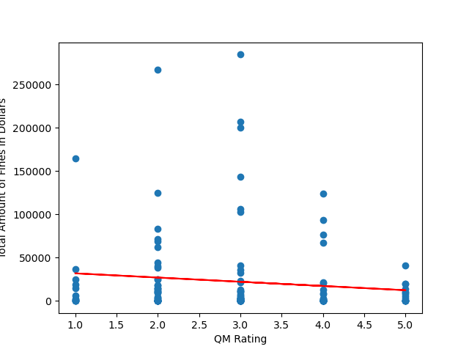

Slide 8
graph

Slide 9
graph

Slide 10
graph

Slide 11
graph

Slide 12
graph

Slide 13
Thank you

